Slide 1

DATA CLUB – MEET I
Topic: Complexity

Slide 2
Types of interviews
Software
Data
Algorithms
Design
SQL
Case Study

Slide 3
Types of job roles (for Applied Mathematicians)
Research Engineer (Algorithms, Distributed Systems)
Machine Learning Engineer (Algorithms, OOPS, Distributed Systems, ML System Design)
Quantitative Researcher (Algorithms, Mathematics, Case Studies)
Software Engineers (Algorithms, OOPS, Distributed Systems)
Data Scientist (Algorithms, SQL, Case Studies)
Data Analyst (Algorithms, SQL, Case Studies)

Slide 4

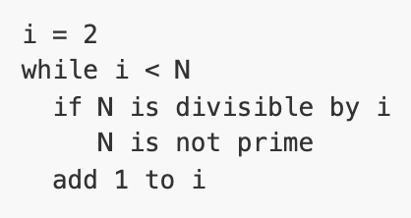
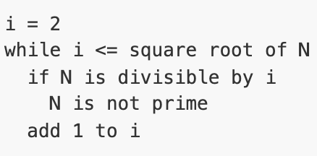
Time Complexity
Let’s assume we ask 2 interviewees A and B to write a program to detect if a number N >= 2 is prime.
Top-down learning
Learn by examples
More practice
Interactive
NOT EASY

Slide 5
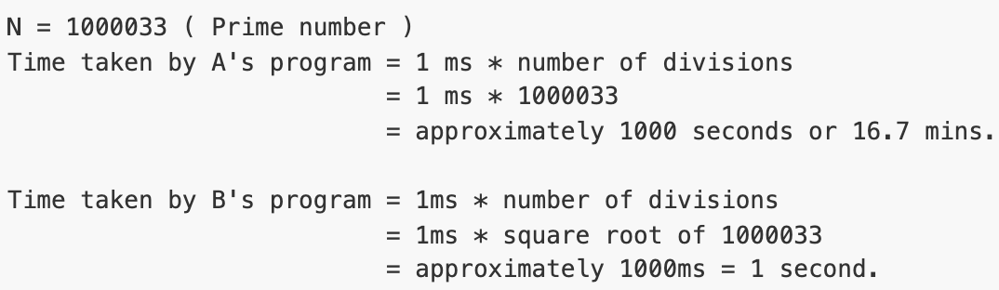
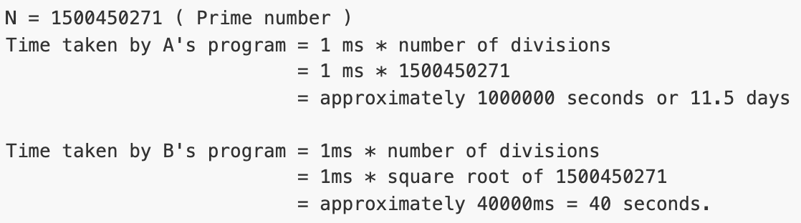
Let’s assume that the operation N is divisible by i takes 1 ms.

Slide 6
Computer scientists have developed a convenient notation for hiding the constant factor.
We write O(n) (read: ''order n'') instead of ''cn for some constant c.’’
Thus, an algorithm is said to be O(n) or linear time if there is a fixed constant c such that for all sufficiently large n, the algorithm takes time at most cn on inputs of size n. An algorithm is said to be O(n²) or quadratic time if there is a fixed constant c such that for all sufficiently large n, the algorithm takes time at most cn² on inputs of size n.
O(1) means constant time.
Polynomial time means n^{O(1)}, or n^{c} for some constant c. Thus, any constant, linear, quadratic, or cubic (O(n³)) time algorithm is a polynomial-time algorithm.
One important advantage of big-O notation is that it makes algorithms much easier to analyze, since we can conveniently ignore low-order terms. For example, an algorithm that runs in time
10n³ + 24n² + 3n log n + 144 is still a cubic algorithm, since
10n³ + 24n² + 3n log n + 144 <= 10n³ + 24n³ + 3n³ + 144n³ <= (10 + 24 + 3 + 144)n³ = O(n³).

Slide 7
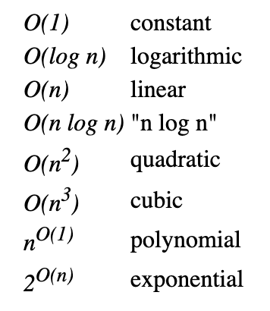
Some common orders of growth seen often in complexity analysis are,

Slide 8
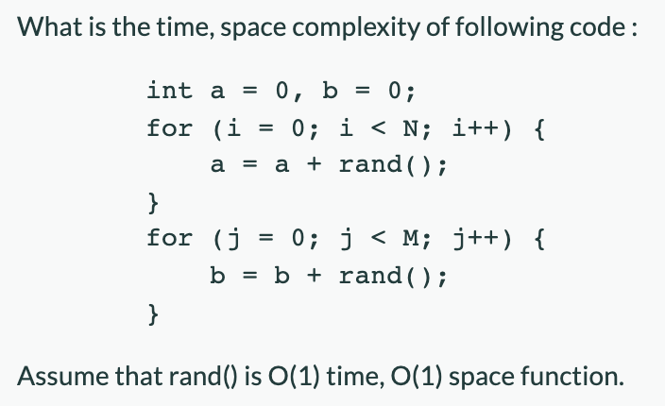
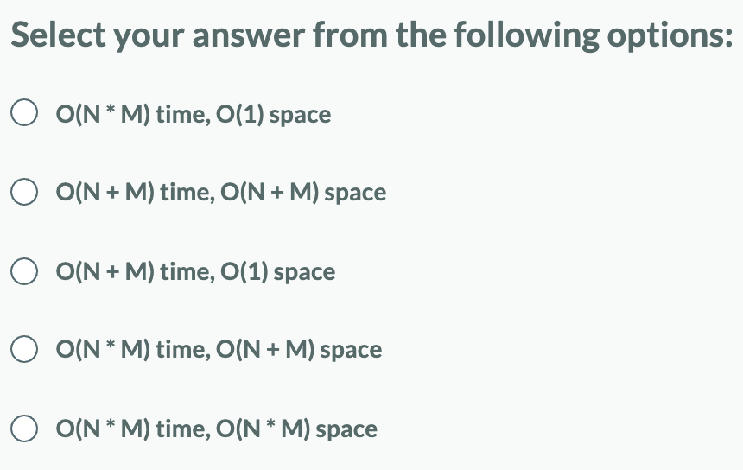
1)

Slide 9
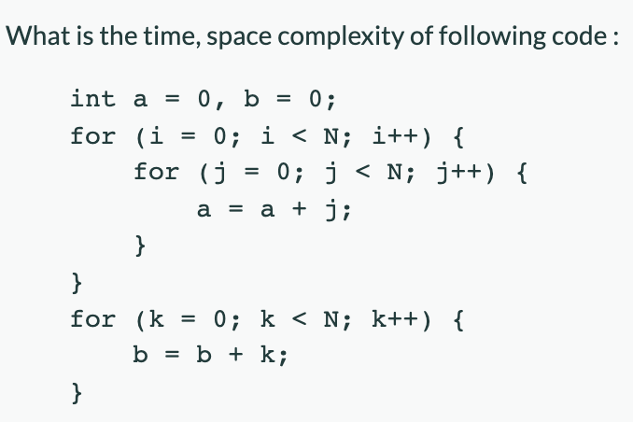
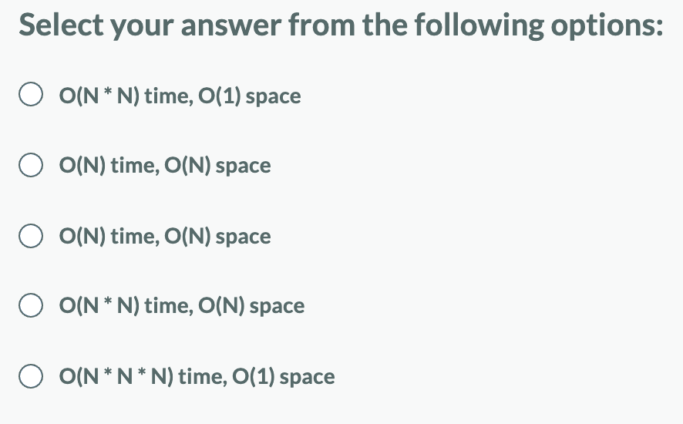
2)

Slide 10
3) What does it mean when we say that an algorithm X is asymptotically more efficient than Y?
X will always be a better choice for all inputs
X will always be a better choice for large inputs
X will always be a better choice for small inputs
Y will always be a better choice for small inputs

Slide 11
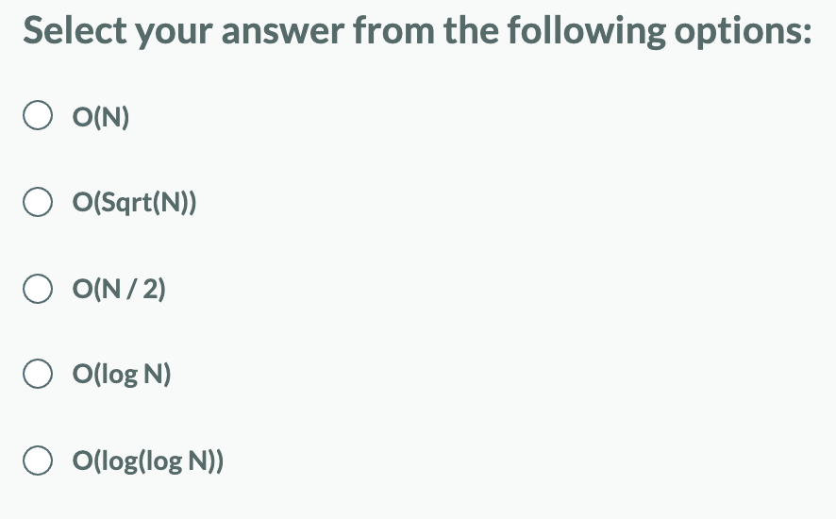
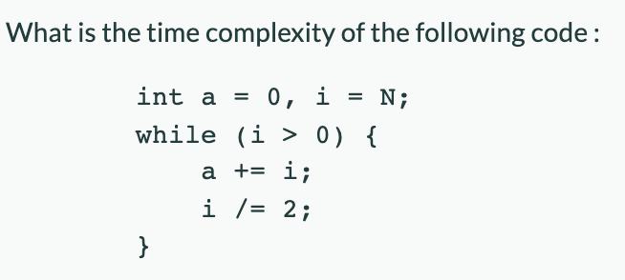
4)

Slide 12
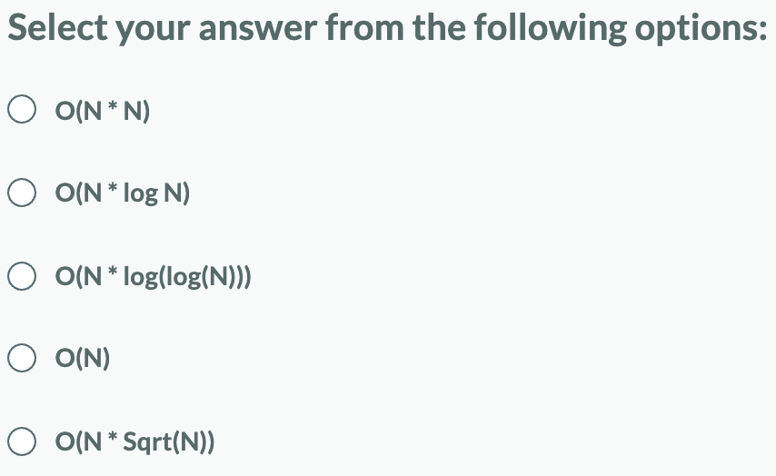
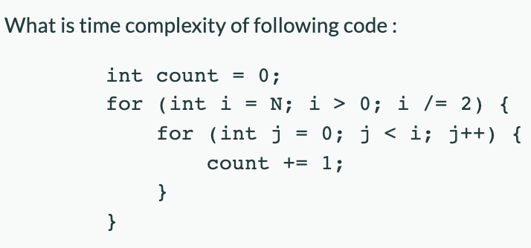
5)

Slide 13
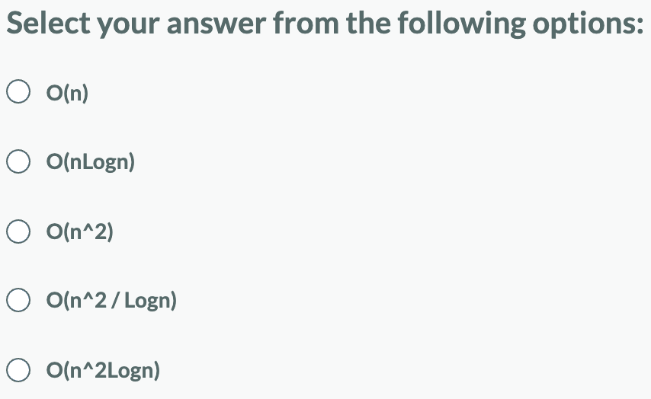
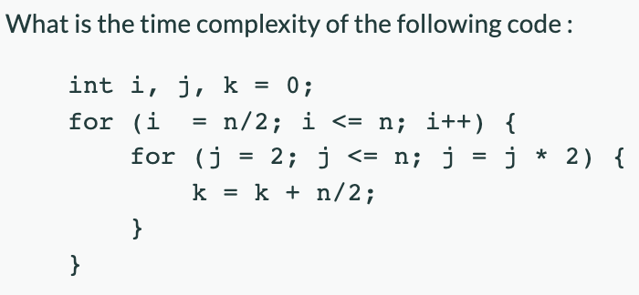
6)

Slide 14
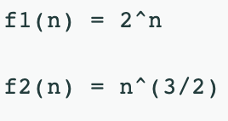
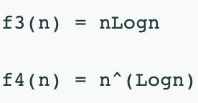
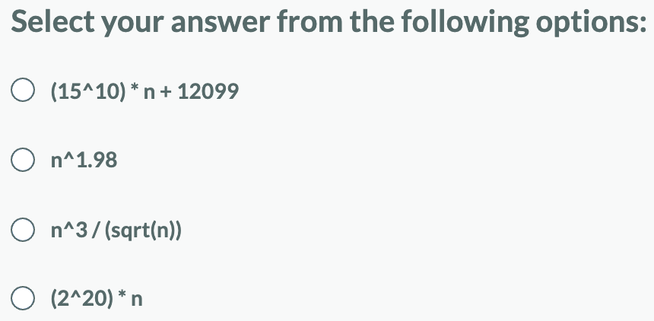
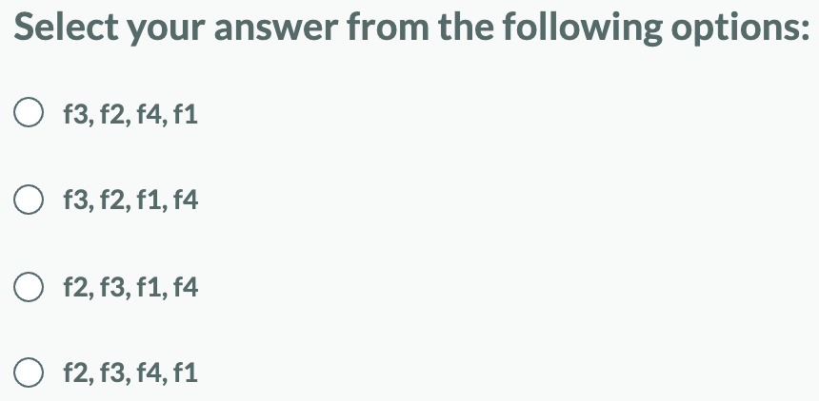
7) Which of the following is not bounded by O(n^2)?
8) Which of the given options provides the increasing order of complexity of functions f1, f2, f3 and f4:

Slide 15
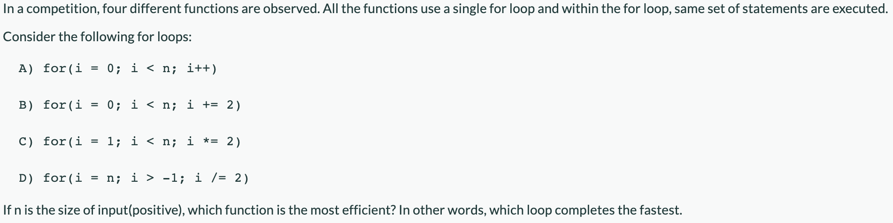
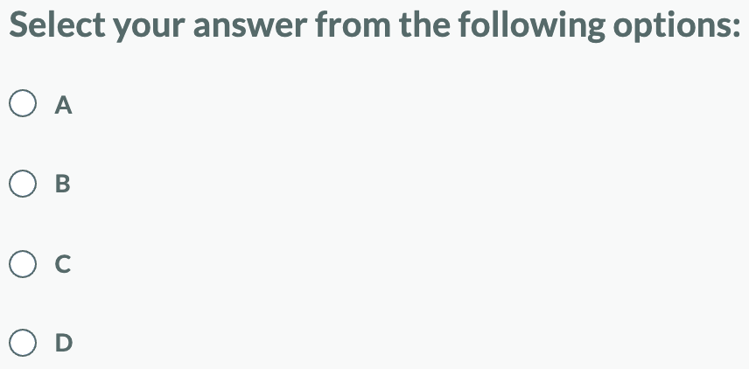
9)

Slide 16
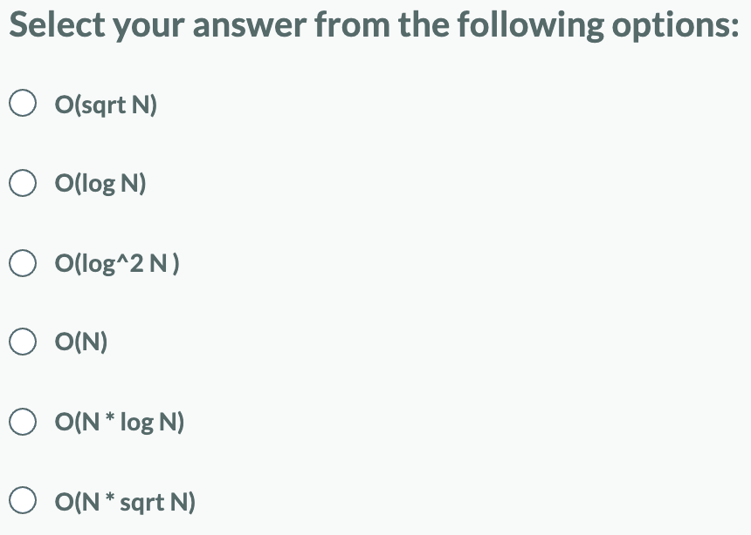
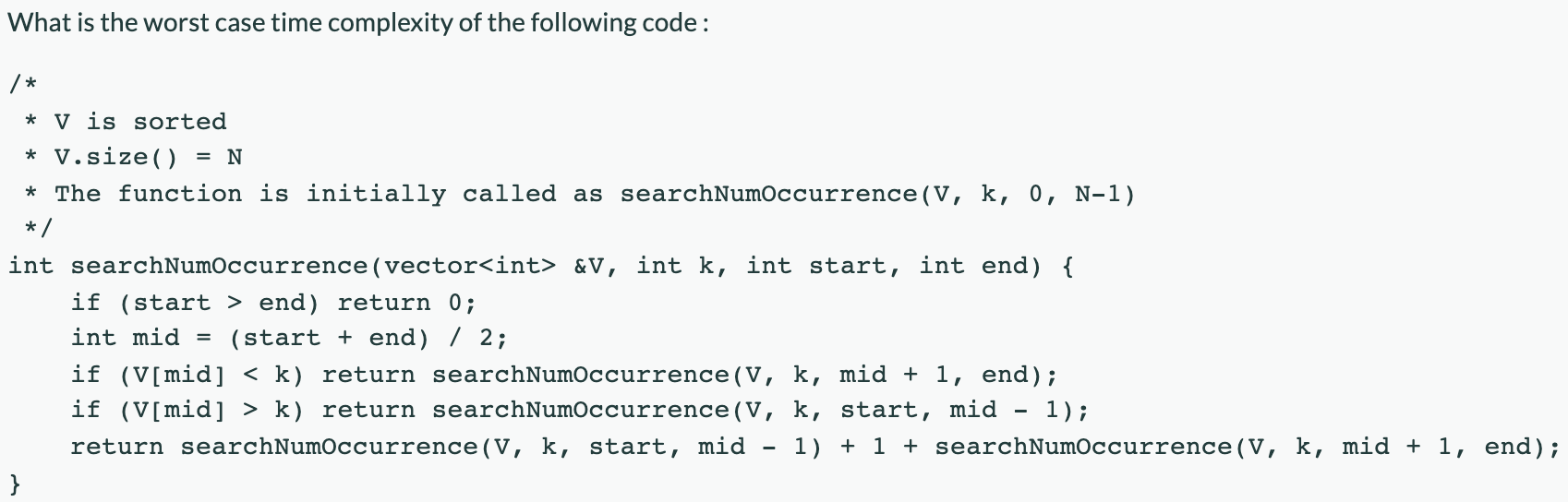
10)

Slide 17
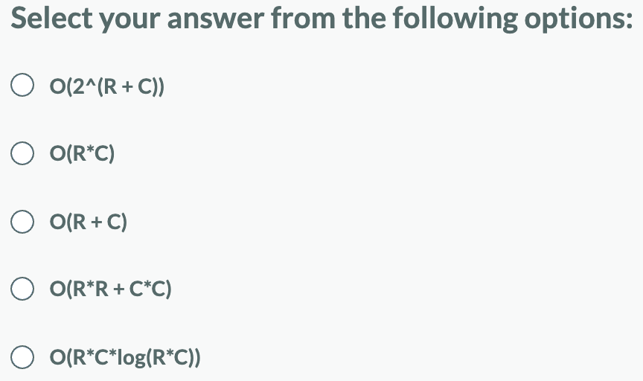
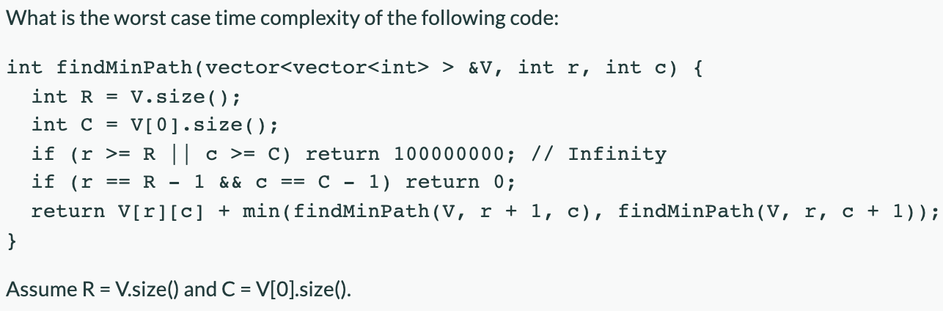
11)

Slide 18
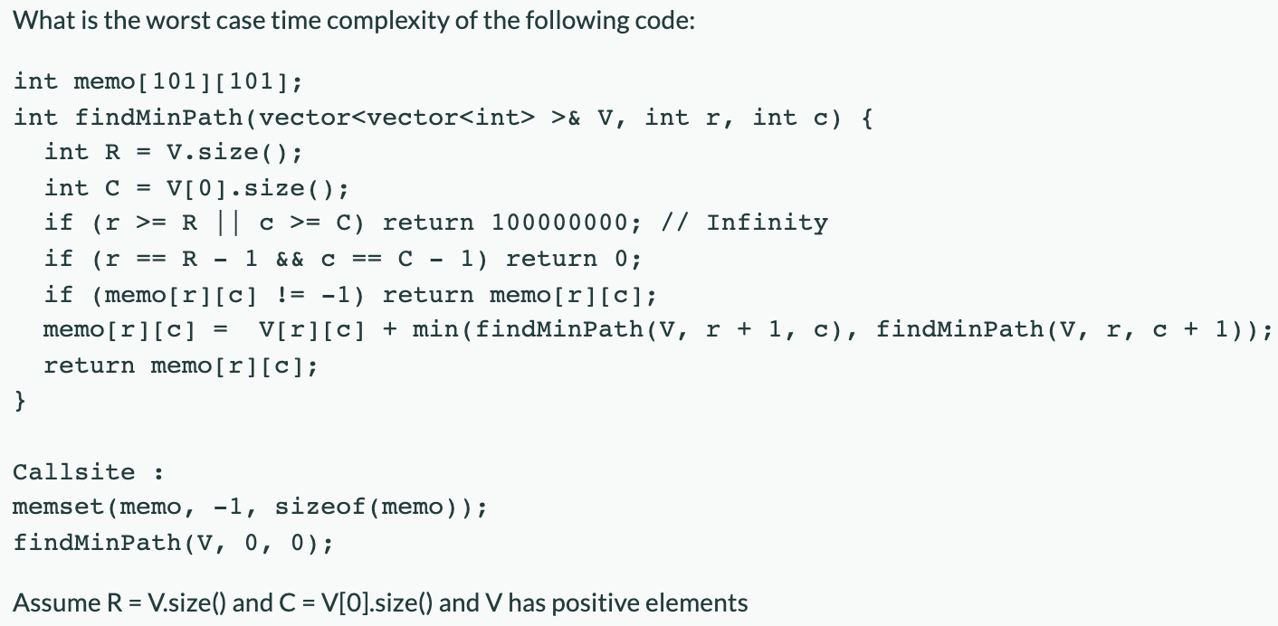
12)

Slide 19
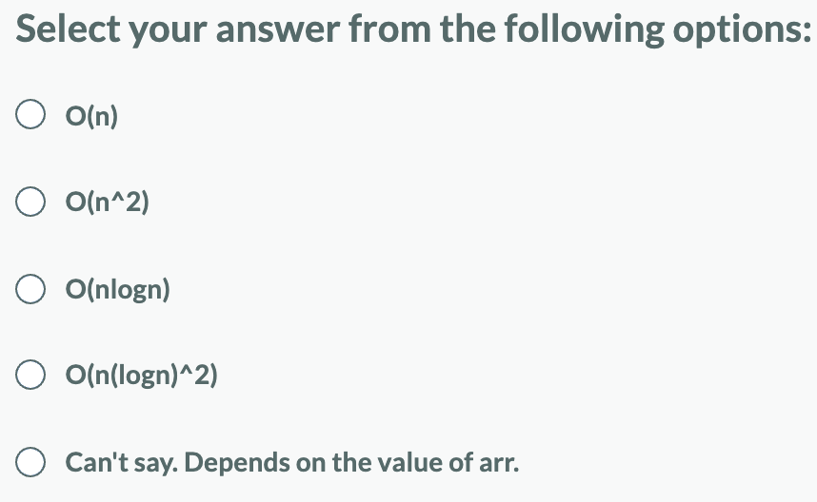
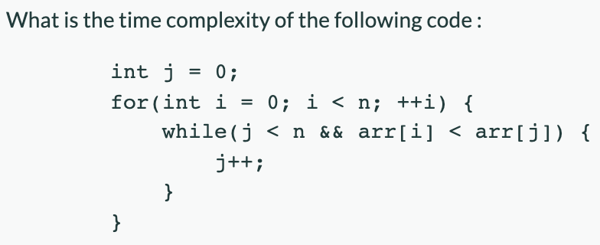
13)

